Slide 1


Effective Implementation of Special & Inclusive Education
AN OVERVIEW OF THE POLICY

Slide 2

ENDORSEMENT
APPROVED BY THE HONOURABLE MINISTER FOR EDUCATION,NATIONAL HERITAGE,CULTURE, AND ARTS, AMBASSADOR FILIPE BOLE
18TH NOVEMBER 2013

Slide 3
Definitions
Inclusive Education: the way in which children with special needs are placed in general education classrooms
Special Education or Special Needs Education:- is the education of students with special needs in a way that addresses the student’s individual differences and needs.

Slide 4
TRADITIONALLY: TWO EDUCATION SYSTEMS
Regular/General/Mainstream Schools: offer curriculum designed/developed by MoE, states, districts. External exams set by state, MoE, etc.
Special Schools: offer educational services for students with diverse educational needs. Focus on individualisation: re:- IEP’s aids/equipment/strategies/interventions

Slide 5
1960s: DISSATISFACTION WITH DUAL EDUCATION SYSTEM
Advocates: One education system should cater for all
A dual system is inefficient
Push from exclusion to inclusion will be beneficial to all students
Other views:
Saving money by having one system is the motive for inclusion

Slide 6
Also in the 60’s
Catholic schools enroll students with special needs
Saint Joseph Secondary
Marist Brothers High Schools
Were the first two schools that took in students with special needs

Slide 7
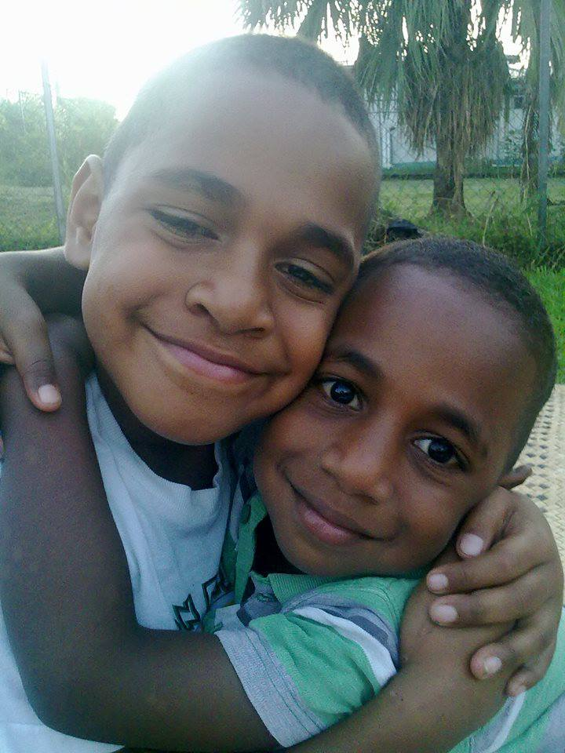
WHY THE POLICY???
So that children with special needs can access quality education in all schools and at all levels.

Slide 8
Global Inclusive Model
NATION
COMMUNITY (Schools, Church)
HOME (Parents, Siblings)
SPECIAL NEEDS CHILD

Slide 9


The Mention of it in the Constitution
ARTICLE 31- THE RIGHT TO Education
ECE, Primary, Secondary & Further education
ARTICLE 42: (1)THE RIGHTS OF PERSONS WITH DISABILITIES
a. To reasonable access to all places.
b. To use appropriate means of communication (sign language or braille)
c. To access materials and devices relating to their disability
(2) Right to reasonable adaptations to buildings, infrastructures vehicles etc.
[ Constitution of the Republic of Fiji, 2013]

Slide 10
TEN Relevant Legislations
Biwako Document (2003-2012)
Fiji Human Rights commission Act (1999)
FNCDP Act of 1994

Slide 11
TEN Relevant Legislations
MoENHCA Co-operate Plan (2012)
National Policy on Persons living with Disabilities (2008-2018)
UN Conventions on the Rights of People with Disabilities Article 24

Slide 12
FUNDAMENTAL PRINCIPLES OF INCLUSION
Inclusion
All children Belong
All children have a right to learn
All children have right to fully participate
All children have a right to live and be well supported

Slide 13

Statement of Principles
People with disabilities in Fiji have the same fundamental rights, freedom and responsibilities as their non-disabled peers. All children have the right to the most appropriate educational programs available to meet their individual needs. Students with special needs require specialized support services to provide them with opportunities to achieve their maximum potential and to become contributing members of society in a dignified and a meaningful way.

Slide 14
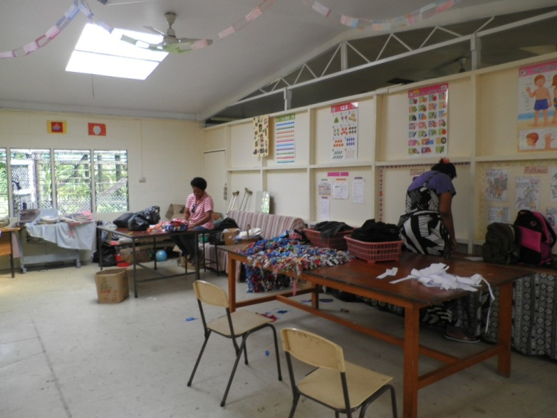
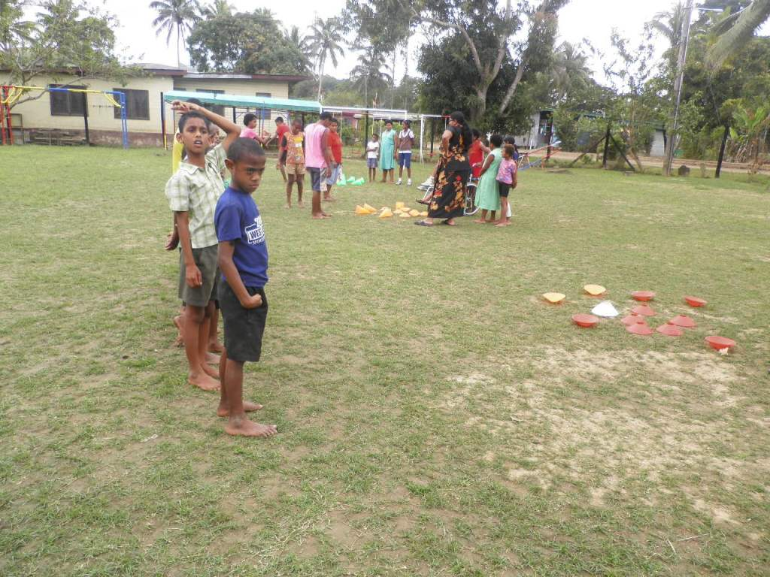
Statement of Principle( cont’d)
The Ministry of Education in Fiji is committed to providing Special/Inclusive Education Services to meet the needs of all special needs students in active partnership with parents and the community.

Slide 15
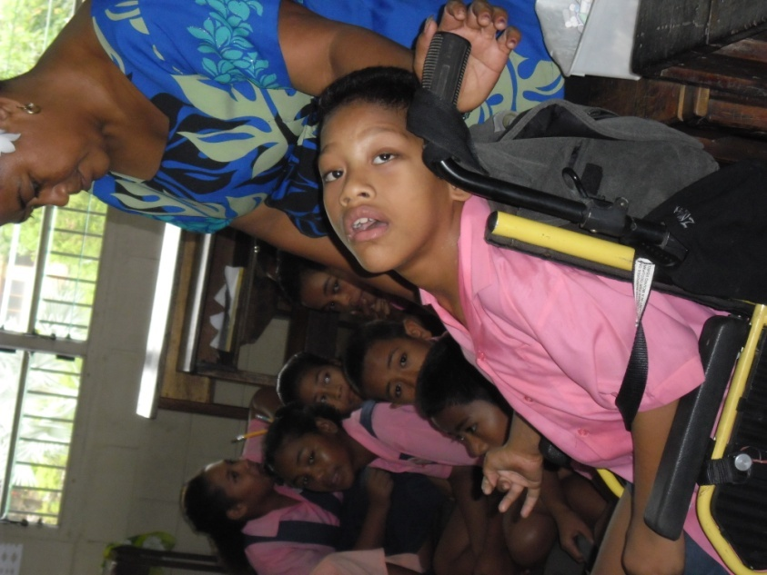
HOW ?????
Children with special needs attend the school closest to their homes
Family members are carers for their children
Parents are actively involved in supporting the school.
Students with special needs draw donors to the school

Slide 16
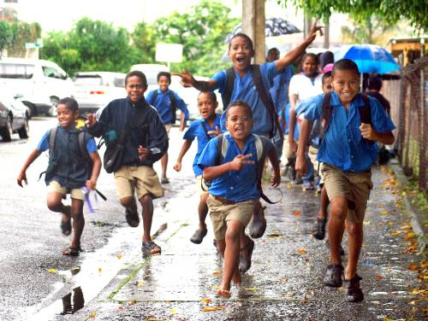
Inclusive Education Policy
“Moreover all children should be given the opportunity to learn together, wherever possible regardless of difficulties, disabilities or differences.” (Policy Objective- IE,MoE)

Slide 17
Mobilising Inclusive Education
Up Skilling existing Teachers
Internal Training for Education Officers
Target teacher training institutions for the inclusion of special & inclusive education programs
Increase staffing & resources in special schools
Secure volunteers in the field of physiotherapy, audiologist, speech pathologist..etc..

Slide 18

Policy Procedures
To be implemented/strengthened
No | Strategies | Key Role Player
1. | Assessment - To determine the correct placement of children | SIEU, SP.Schools, SENCO’s
2. | Placement-Diagnosis of Disability/ Confirming the disability | MoH-Specialist Volunteers
3. | Curriculum-Translation of curriculum into Sign Language & Braille | SIEU, Curriculum Review Group
4. | Training of Teachers | SIEU, AQEP, SENCO’s
5. | Appropriate Financial Support to inclusive/mainstream schools | MOENHCA
6. | Raising Awareness for Inclusion ,Support to Parents & the School Community | Special Schools, DPO’s, SENCO’s

Slide 19
Policy Procedures
To be implemented/strengthened
No | Strategies | Key Role Player
1. | Strengthening Teacher Education at Teacher Training Institutions | FNU, CCTS, FC
2. | Appropriate Teaching Staff made available | District PEO’s, PEOP, DPE
3. | One Special Needs Officer per district | PEOs
4. | One Inclusive School per district | PEOs
5. | Integration & Inclusion –Tertiary level | SIEU,TVET,PSC
6. | Review of Budget to Increase S.E grant | SIEU

Slide 20
Integrated Cluster Approach
SPECIAL SCHOOL
Inclusive Mainstream School
Inclusive Mainstream School
Inclusive Mainstream School
Inclusive Mainstream School

Slide 21
Example: Macuata/Bua District
LABASA SPECIAL SCHOOL
Labasa Primary School
Saint Mary School
Bethel Primary
Holy Family Primary

Slide 22
6.10.3
Each Child will receive a disability grant per year

Slide 23
6.10.3
Every inclusive School will need teacher aide support

Slide 24

Degree of Disability
Mild
Ratio 1:2
Moderate
Ratio 1: 4
Severe
Ratio 1: 6

Slide 25
Specialist Support
Audiologist
Braille & De-Braille Readers & Writers
Speech Pathologist
Occupational Therapist
Educational Psychologist
Physiotherapist
Counsellors
O&M Trainers, etc.

Slide 26
IE may take a while .
A long journey begins with a single step

Slide 27
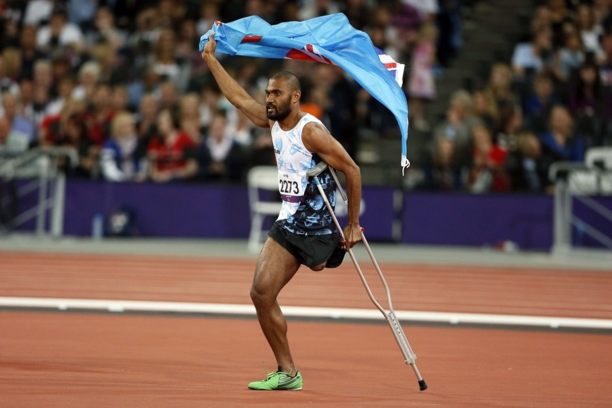
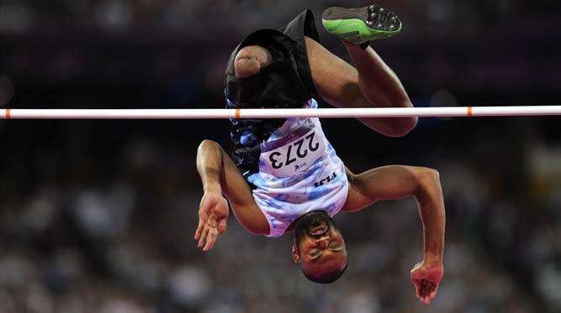
Everyone Can Achieve….

Slide 28

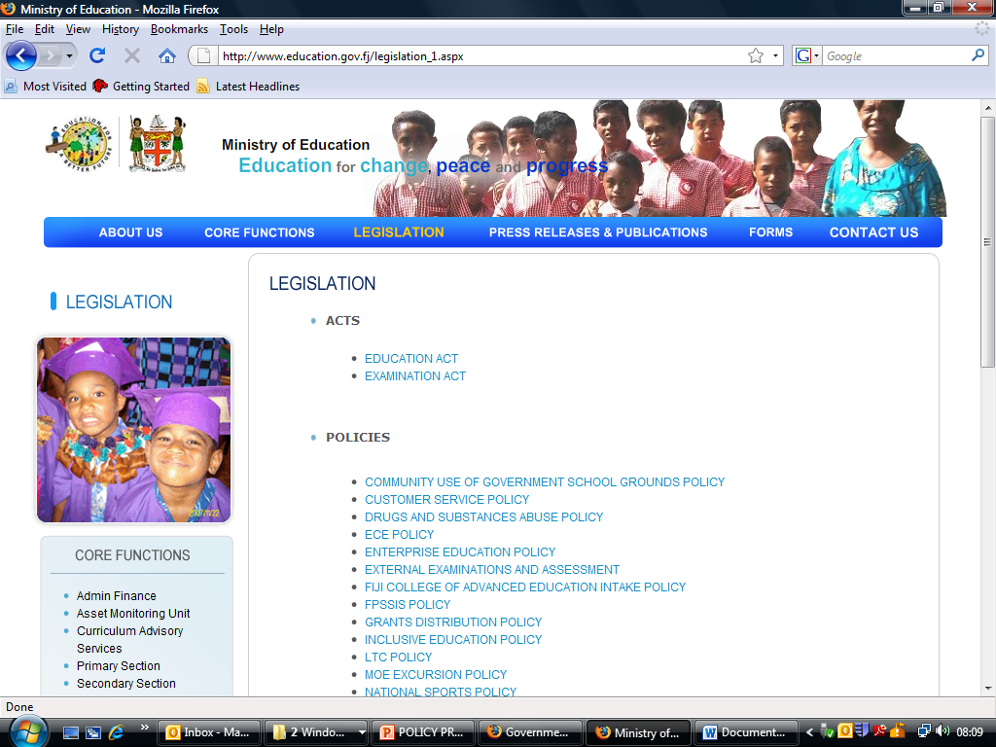
Official MoE Website

Slide 29
THANK YOU

